Slide 1


Quantitative genetics
Gib Hemani

Slide 2
Outline
Heritability
Polygenic model
Liability vs observed scale
Notes:
Objective – get a sense of the agility of using data to estimate heritability

Slide 3
Heritability

Slide 4
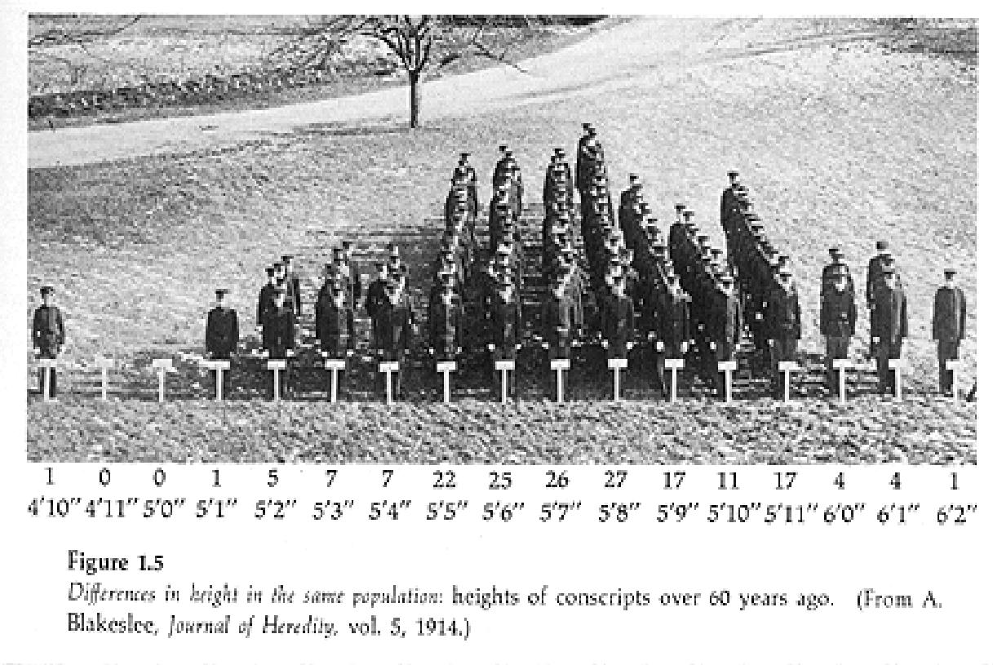
Variation
Notes:
Why are there differences amongst people in the population?
How much of this is due to genetic effects
There are lots of different ways to approach this question

Slide 5
Heritability
The resemblance between relatives
Due to shared genetics?
The amount of variation in a trait that is due to genetic differences between individuals
Notes:
These are two rather different definitions, but they actually pertain to the same thing
We will be thinking about heritability very much in terms of (2)
But we will be using (1) as a tool to make these estimates

Slide 6
Simplest method: correlation between monozygotic twins
Monozygotic twin ID | Twin 1 (y1) | Twin 2 (y2)
1 | 0.2 | 0.2
2 | 0.5 | 0.6
3 | 0.3 | 0.4
4 | 0.7 | 0.2
5 | 0.4 | 0.5
6 | 0.1 | 0.3
Correlation between y1 and y2 is an upper bound of the heritability
But this is not so reliable
– what if they are only similar because they are raised in the same environment??
Notes:
If you have a genetic clone, then if the trait is at all heritable then to some extent you should be able to predict one clone’s phenotype based on knowledge of the other clone’s phenotype.
The accuracy of this prediction is measured by correlation.
The higher the correlation, the higher the genetic contribution to the trait

Slide 7
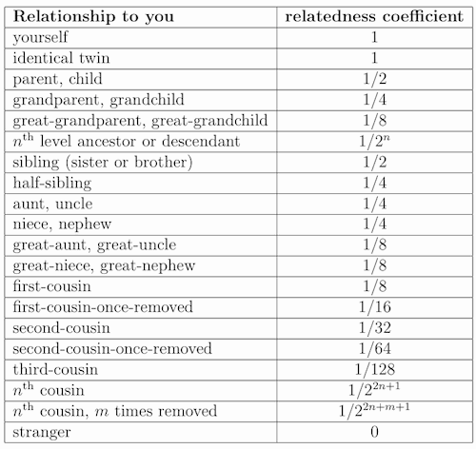
Measuring genetic similarity
MZ
DZ
Notes:
Could argue that if a trait has a genetic basis then monozygotes should be twice as similar to each other as dizygotes
Monozygotes share all genetic factors
Dizygotes only share 50% of genetic factors (i.e. they DON’T share the other 50% - this means that those genetic factors can introduce differences)

Slide 8
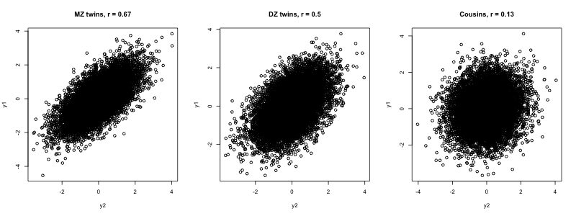
Phenotypic similarity between relatives
Notes:
We might see correlations that look like this between pairs of MZ, DZ, and cousins
How can we estimate heritability with this information?

Slide 9
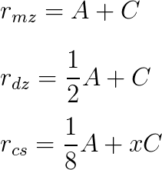
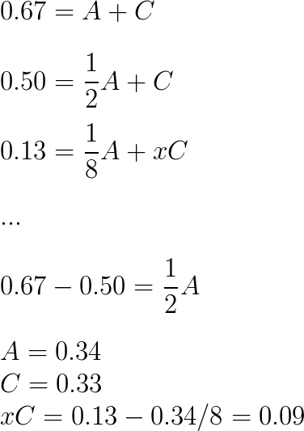
Falconer’s method for estimating heritability
What contributes to the phenotypic correlations?
Let’s estimate the additive and common environmental effects

Slide 10
Falconer’s method
Assumes additive genetic effects
Assumes same common environment amongst MZ and amongst DZ
Simple statistical framework

Slide 11
Concept
If people who are more genetically similar are also more phenotypically similar, this is evidence that the trait is heritable
The extent to which this relationship holds is a measure of the heritability

Slide 12
Measuring phenotypic (dis)similarity
Twin type | Twin 1 (y1) | Twin 2 (y2) | Dissimilarity (y1 – y2)²
Monozygote | 0.2 | 0.2 | 0
Monozygote | 0.5 | 0.6 | 0.01
Dizygote | 0.3 | 0.4 | 0.01
Dizygote | 0.7 | 0.2 | 0.25
Monozygote | 0.4 | 0.5 | 0.01
Dizygote | 0.1 | 0.3 | 0.04

Slide 13
Haseman-Elston method for estimating heritability
Here, the heritability can be estimated using the slope
= -2var(A)
Using MZ and DZ twins
Note – this is never actually used, we’ll discuss later
Notes:
Information can be obtained

Slide 14
Measuring phenotypic (dis)similarity
Twin type | Relationship coefficient | ID 1 (y1) | ID 2 (y2) | Dissimilarity (y1 – y2)²
Monozygote | 1 | 0.2 | 0.2 | 0
Siblings | 0.5 | 0.5 | 0.6 | 0.01
Dizygote | 0.5 | 0.3 | 0.4 | 0.01
Cousins | 0.125 | 0.7 | 0.2 | 0.25
Half-siblings | 0.25 | 0.4 | 0.5 | 0.01
Parent-offspring | 0.5 | 0.1 | 0.3 | 0.04

Slide 15
Haseman-Elston method for estimating heritability
Using multiple types of relationships
Here, the heritability can be estimated using the slope
= -2var(A)
Notes:
Information can be obtained

Slide 16
Heritability tells us:
The influence of nature vs nurture on the variation of a trait in a population
If there is any a priori reason to perform a GWAS
If heritability estimates of the same trait differ in different populations
If heritability estimates of different traits differ in the same population
The maximum possible prediction accuracy of a trait using genetic measures alone
How a trait will respond to natural selection

Slide 17
Huge number of studies have been performed to estimate heritability
Visscher 2008

Slide 18
Thinking about heritability in terms of variation
Notes:
Why are people different to each other? Why is there variation in natural populations?

Slide 19
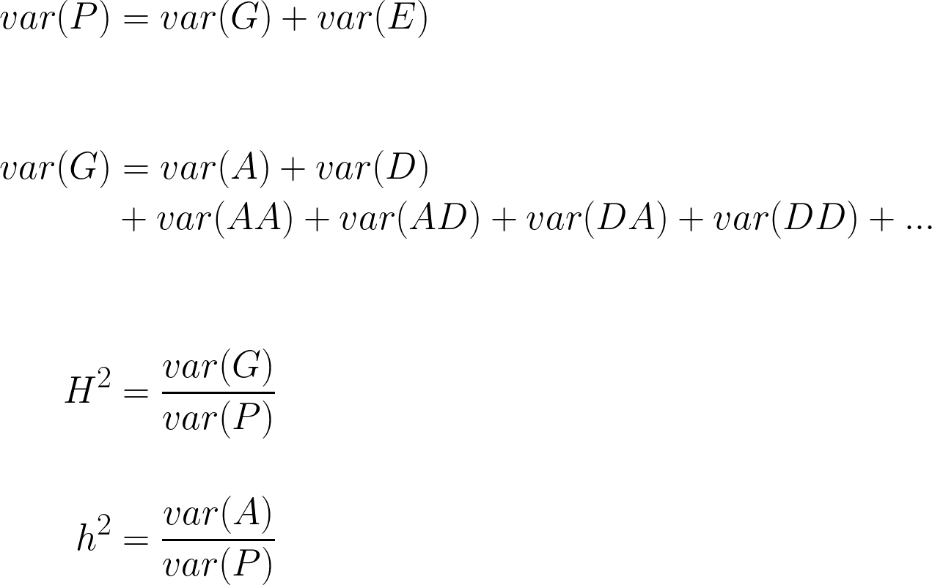
Nature versus and nurture
Phenotypic variance
Variance explained by genetic factors
Variance due to environmental factors or random noise
Additive genetic variance
Dominance variance component
Epistatic variance components
Broad sense heritability
Narrow sense heritability

Slide 20
Var(p) = 0.25 + 0.25 h² = 0.25 / 0.5 = 0.5

Slide 21
Var(p) = 0.63 + 0.04 h² = 0.63 / 0.67 = 0.94

Slide 22
Var(p) = 0.0025 + 0.249 = 0.252 h² = 0.0025 / 0.25 = 0.01

Slide 23
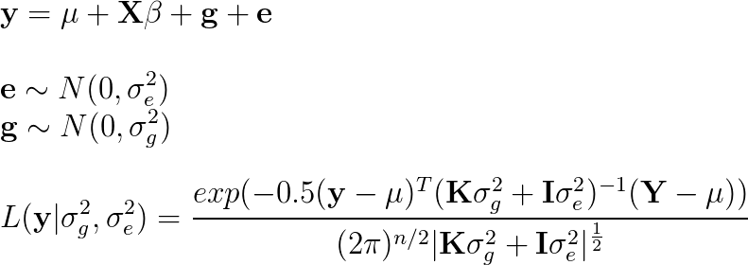
Mixed model approach
Partition variance into covariates,
genetic effects and residuals
Use REML to maximise likelihood for estimation of σ_{g}² and σ_{e}² parameters

Slide 24
Measuring genetic similarity
Notes:
Could argue that if a trait has a genetic basis then monozygotes should be twice as similar to each other as dizygotes
Monozygotes share all genetic factors
Dizygotes only share 50% of genetic factors (i.e. they DON’T share the other 50% - this means that those genetic factors can introduce differences)

Slide 25
Mixed model approach
1 0.5 0.13 0.01 0.09 0.01
0.5 1 0.13 0.02 0.07 0.04
0.13 0.13 1 0.03 0.01 0.05
0.01 0.02 0.03 1 0.25 1
0.09 0.07 0.01 0.25 1 0.38
0.01 0.04 0.05 1 0.38 1
1
1
1
-1
-1
-1
1 1 1 -1 -1 -1
1 1 1 -1 -1 -1
1 1 1 -1 -1 -1
-1 -1 -1 1 1 1
-1 -1 -1 1 1 1
-1 -1 -1 1 1 1
σ_{g}²
σ_{e}²
Phenotype Y
Phen covariance YY^{T}
1 0 0 0 0 0
0 1 0 0 0 0
0 0 1 0 0 0
0 0 0 1 0 0
0 0 0 0 1 0
0 0 0 0 0 1
Use REML to divide phenotypic variance into:
σ_{g}² = Genetic covariance matrix
σ_{e}² = Residual error
Then we can estimate h² = σ_{g}² / (σ_{g}² + σ_{e}²)

Slide 26
Polygenic traits

Slide 27
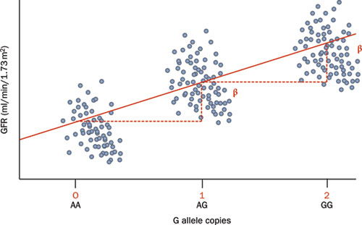
Continuous traits from discrete effects?
Variation in the population
Genetic effects are additive
Notes:
Many traits of interest are measured on a continuous scale. Yet genetic inheritance is discrete – you either inherit a causal allele or you don’t. How can continuous variation arise from discrete genetic elements?

Slide 28
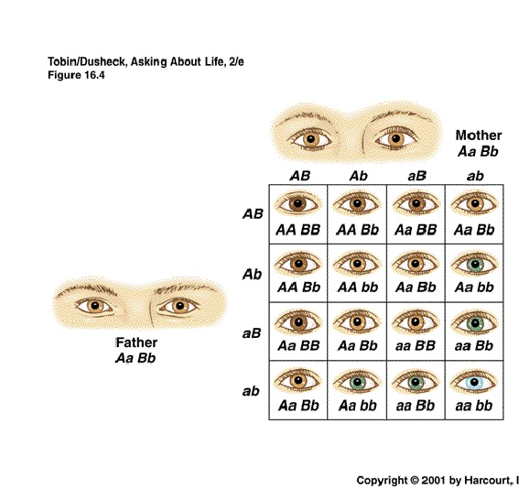
2 independent loci, 2 alleles each, each major allele contributes to darker eye colour
Record the number of major alleles for each genotype and calculate the possible phenotypes for eye colour
Parents heterozygotes for both loci
Fill grid with number major alleles for each genotype
Slide courtesy of Evie Stergiakouli
Notes:
Imagine a trait that is influenced by two different loci. If you have risk alleles at both loci you have additively higher risk
What is the distribution of number of disease alleles inherited?

Slide 29
3 independent loci, 2 alleles each
Mother AaBbCc
Possible gamete genotypes | ABC | ABc | AbC | aBC | abC | aBc | Abc | abc
ABC | AABBCC | AABBCc | AABbCC | AaBBCC | AaBbCC | AaBBCc | AABbCc | AaBbCc
ABc | AABBCc | AABBcc | AaBbCc | AaBBCc | AaBbCc | AaBBcc | AABbcc | AaBbcc
AbC | AABbCC | AABbCc | AAbbCC | AaBbCC | AabbCC | AaBbCc | AAbbCc | AabbCc
aBC | AaBBCC | AaBBCc | AaBbCC | aaBBCC | aaBbCC | aaBBCc | AaBbCc | aaBbCc
abC | AaBbCC | AaBbCc | AabbCC | aaBbCC | aabbCC | aaBbCc | AabbCc | aabbCc
aBc | AaBBCc | AaBBcc | AaBbCc | aaBBCc | aaBbCc | aaBBcc | AaBbcc | aaBbcc
Abc | AABbCc | AABbcc | AAbbCc | AaBbCc | AabbCc | AaBbcc | AAbbcc | Aabbcc
abc | AaBbCc | AaBbcc | AabbCc | aaBbCc | aabbCc | aaBbcc | Aabbcc | aabbcc
Father AaBbCc
Notes:
We can do the same for a trait controlled by 3 loci

Slide 30
3 independent loci, 2 alleles each
Fill grid with number of dominant alleles for each genotype

Slide 31
3 independent loci, 2 alleles each, 27 genotypes
6 | 5 | 5 | 5 | 4 | 4 | 4 | 3
5 | 4 | 4 | 4 | 3 | 3 | 3 | 2
5 | 4 | 4 | 4 | 3 | 3 | 3 | 2
5 | 4 | 4 | 4 | 3 | 3 | 3 | 2
4 | 3 | 3 | 3 | 2 | 2 | 2 | 1
4 | 3 | 3 | 3 | 2 | 2 | 2 | 1
4 | 3 | 3 | 3 | 2 | 2 | 2 | 1
3 | 2 | 2 | 2 | 1 | 1 | 1 | 0

Slide 32
Generation of a quantitative phenotype
3 loci result in 27 genotypes and 7 different combinations
Notes:
So from 3 loci we can have 7 different values

Slide 33
200 Causal variants
The variance of this distribution is var(g)
Notes:
With 200 causal loci we can have 401 different possible values

Slide 34
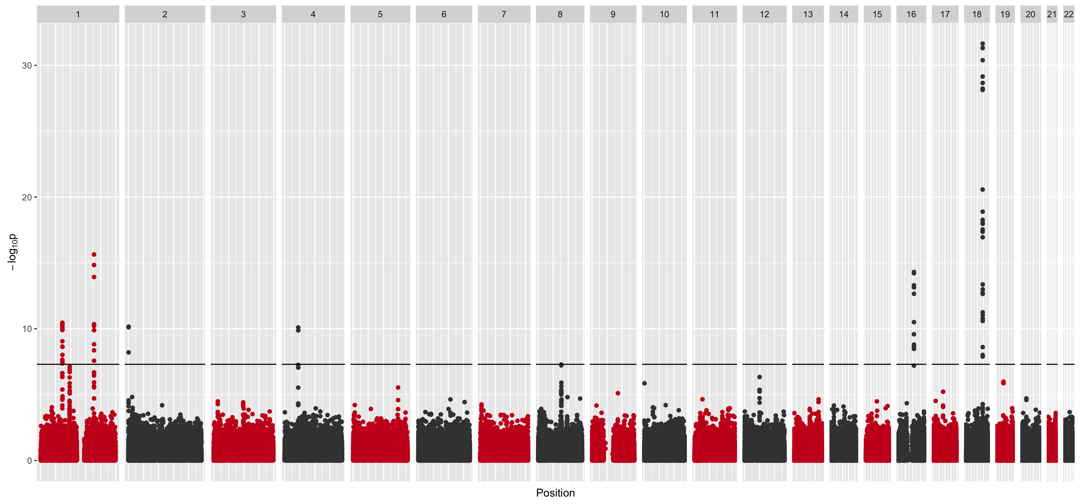
Not all SNPs have the same contribution
Notes:
Why are there some large peaks and some small peaks?

Slide 35
Polygenic risk scores (PRS)
Many names…
Polygenic risk scores
Breeding value
Genetic profile score
If every causal variant has the same effect size, then an individual’s risk score is just counting the number of risk alleles

Slide 36
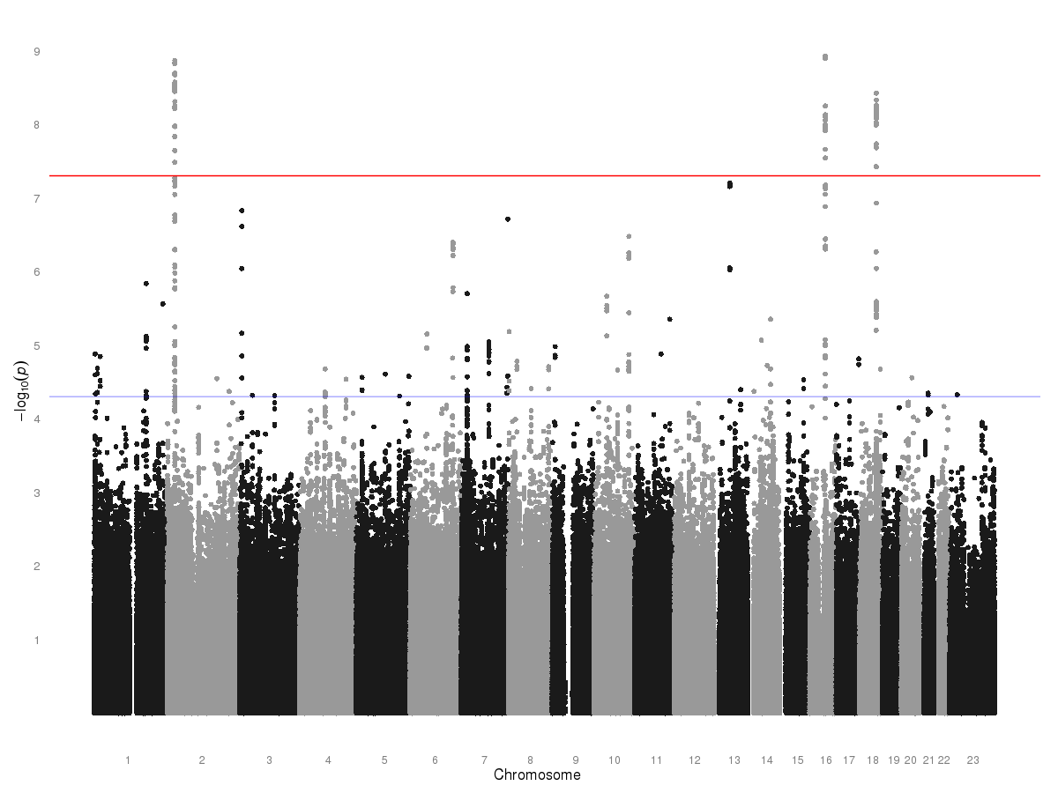
Discovery/training sample
LD prune results, keep most associated SNP of each pair
Select p value threshold:
P<1e-8
Samples need to be completely independent
Validation/ target sample
Construct polygenic score on each person based on genome-wide data
Test for association between polygenic scores and phenotype/traits

Slide 37
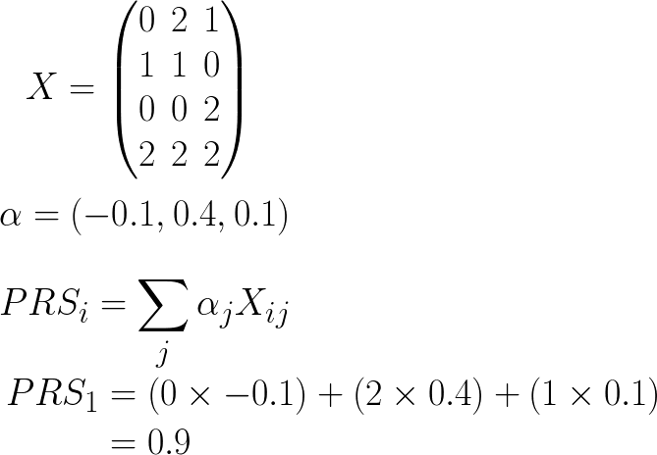
Polygenic risk scores (PRS
If the effects for causal variants are different then an accurate measure of PRS should account for this by weighting the contribution of each SNP
The SNP effects to be used are obtained from a training sample
4 individuals
3 SNPs
The effects of each SNP
The PRS for individual 1

Slide 38
The PRS is constructed in a testing sample
ID | PRS | Actual phenotype
1 | 0.9 | 0.6
2 | 0.2 | 0.6
3 | 0.4 | 0.4
4 | 0.6 | 0.5
5 | 0.3 | 0.1
and the phenotypes in that testing sample is correlated with the PRS

Slide 39
Which SNPs to include?

Slide 40
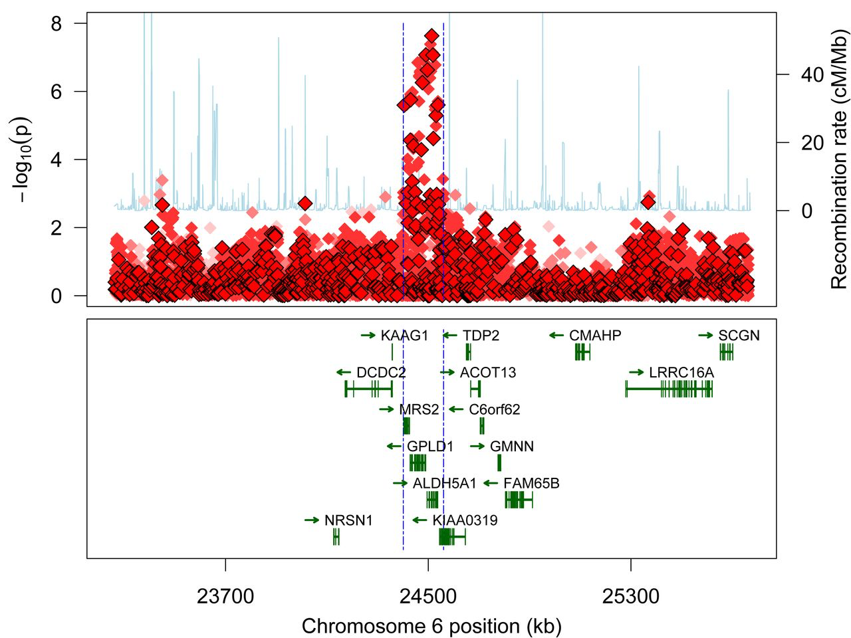
Clumping – keep one top SNP per locus
Notes:
Find the best SNP, remove everything that has R^2 over some threshold within a specified window. Typically remove any SNP with R^2 > 0.1 within 1Mb window. Anything that remains above the threshold will be retained
Why clumping? Most causal variants have LD with lots of SNPs. Every LD SNP is essentially ‘double counting’ the effect of the causal variant.

Slide 41
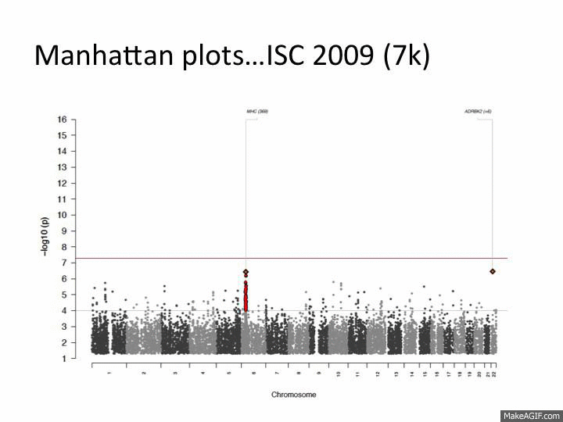

Slide 42
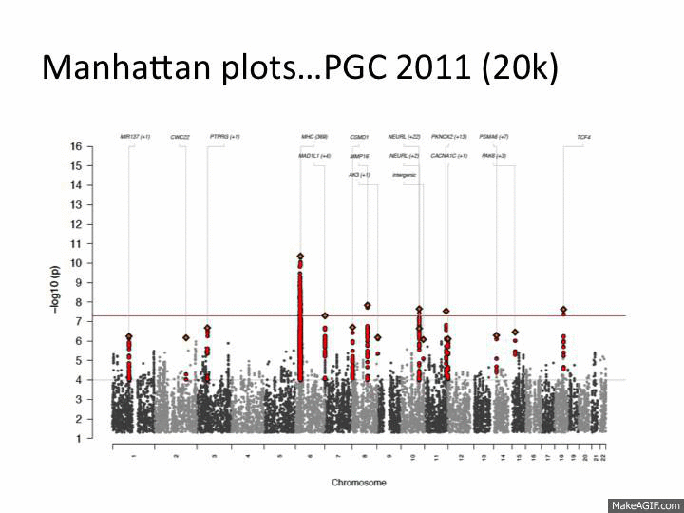

Slide 43
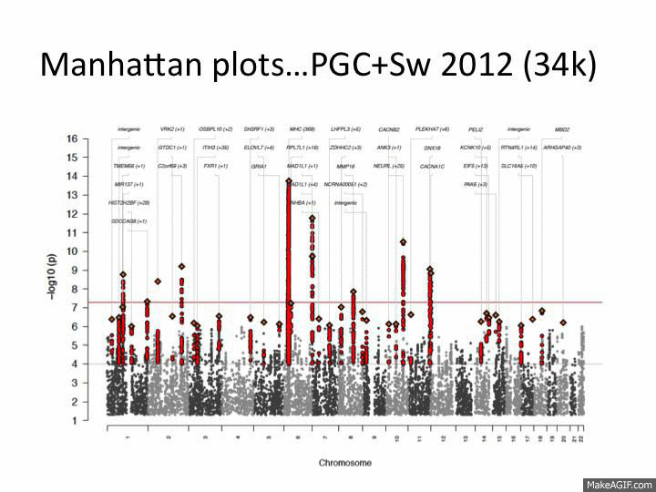

Slide 44
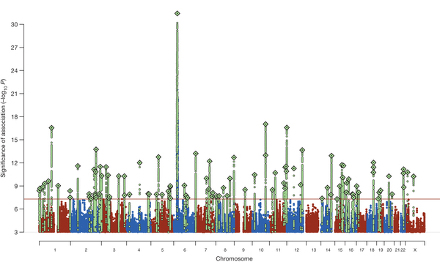
2014: 37k cases and 113k controls, 108 loci

Slide 45
The infinitesimal model
“Every SNP has an effect, but every effect is very small”
Not necessarily true but a useful model
Increased sample size enables discovery of more effects
There are false negatives in GWAS
Notes:
The objective of GWAS is to be sure that a particular SNP has a real effect, hence a strict significance threshold
This means that GWAS is happy to miss many true associations in order to ensure there are no false positives

Slide 46
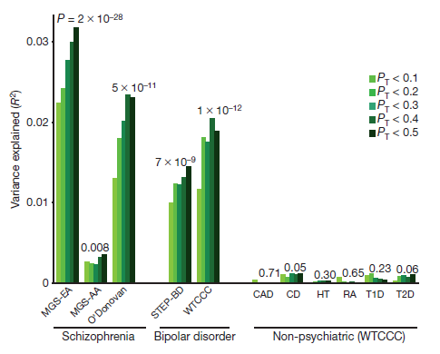
Using SNPs below the threshold in PRS
Purcell et al Nature 2009
Notes:
Note that including MORE SNPs by relaxing the threshold lead to better correlation

Slide 47
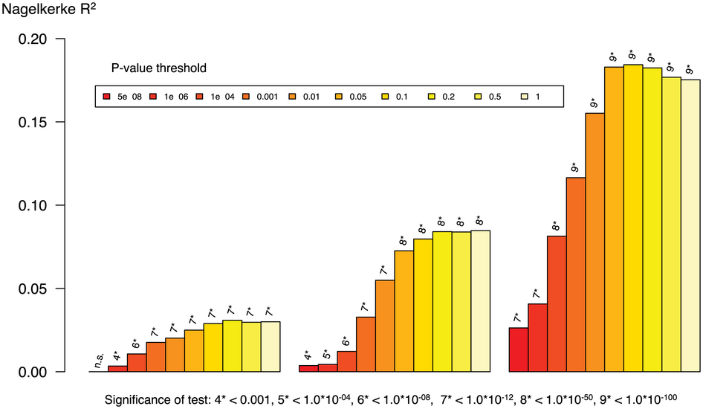
Polygenic scores for schizophrenia explain ~2% of variance
Notes:
Each set of bars is creating scores in a different dataset, and testing the score in an independent outcome

Slide 48
Additive effect = Change in phenotype for every extra effect allele

Slide 49
Var(p) = 0.63 + 0.04 h2 = 0.63 / 0.67 = 0.94

Slide 50
What determines the p-values?
Additive genetic variance of the SNP
Allele frequency
Effect size
Notes:
The effect size, sample size and allele frequency all

Slide 51
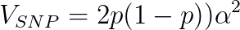
SNP effects relating to heritability

Slide 52
QUESTIONS
Why is the prediction accuracy low?
What is the upper limit of prediction accuracy using genetic factors?

Slide 53
Disease phenotypes

Slide 54
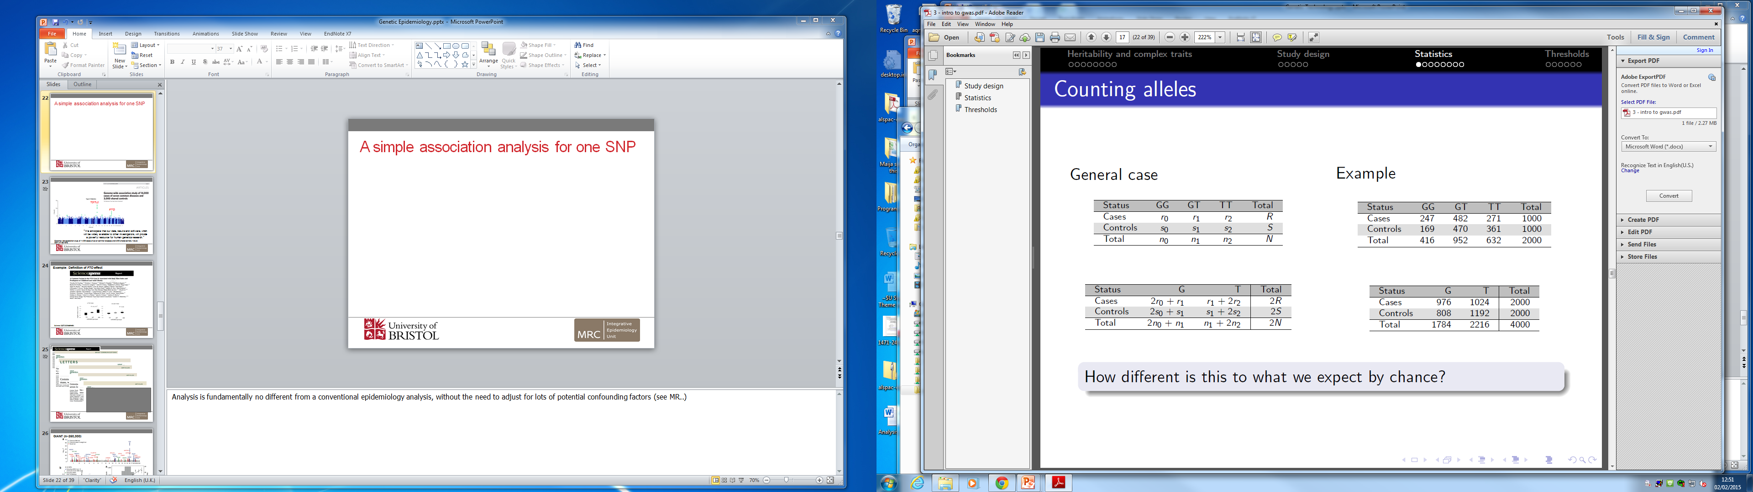
A simple association analysis for one SNP and a binary outcome
General case
Example
How different is this to what we expect by chance?
Statistical test?
Chi squared test
Odds ratio

Slide 55
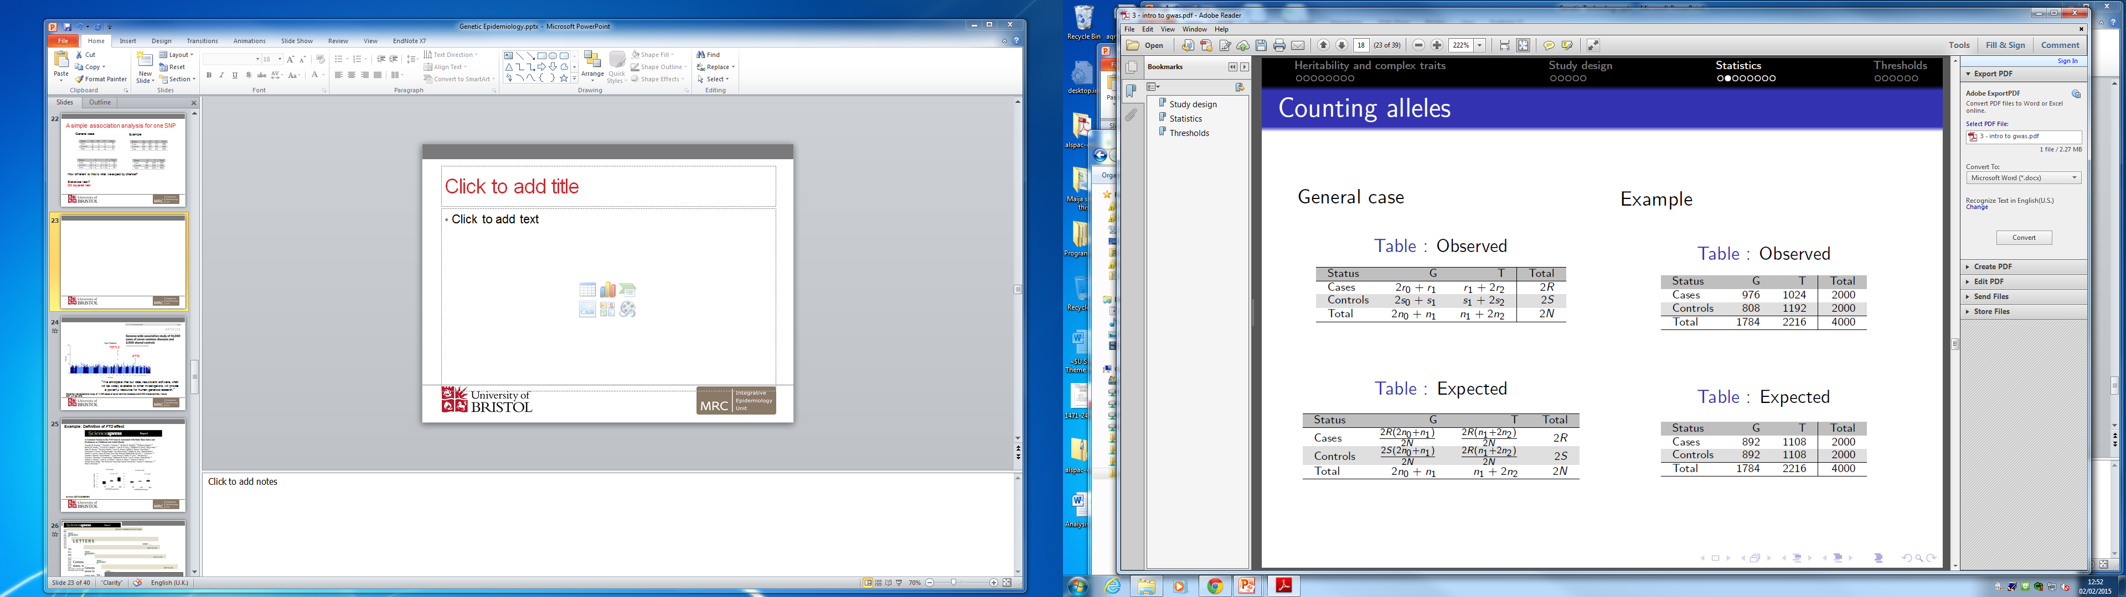
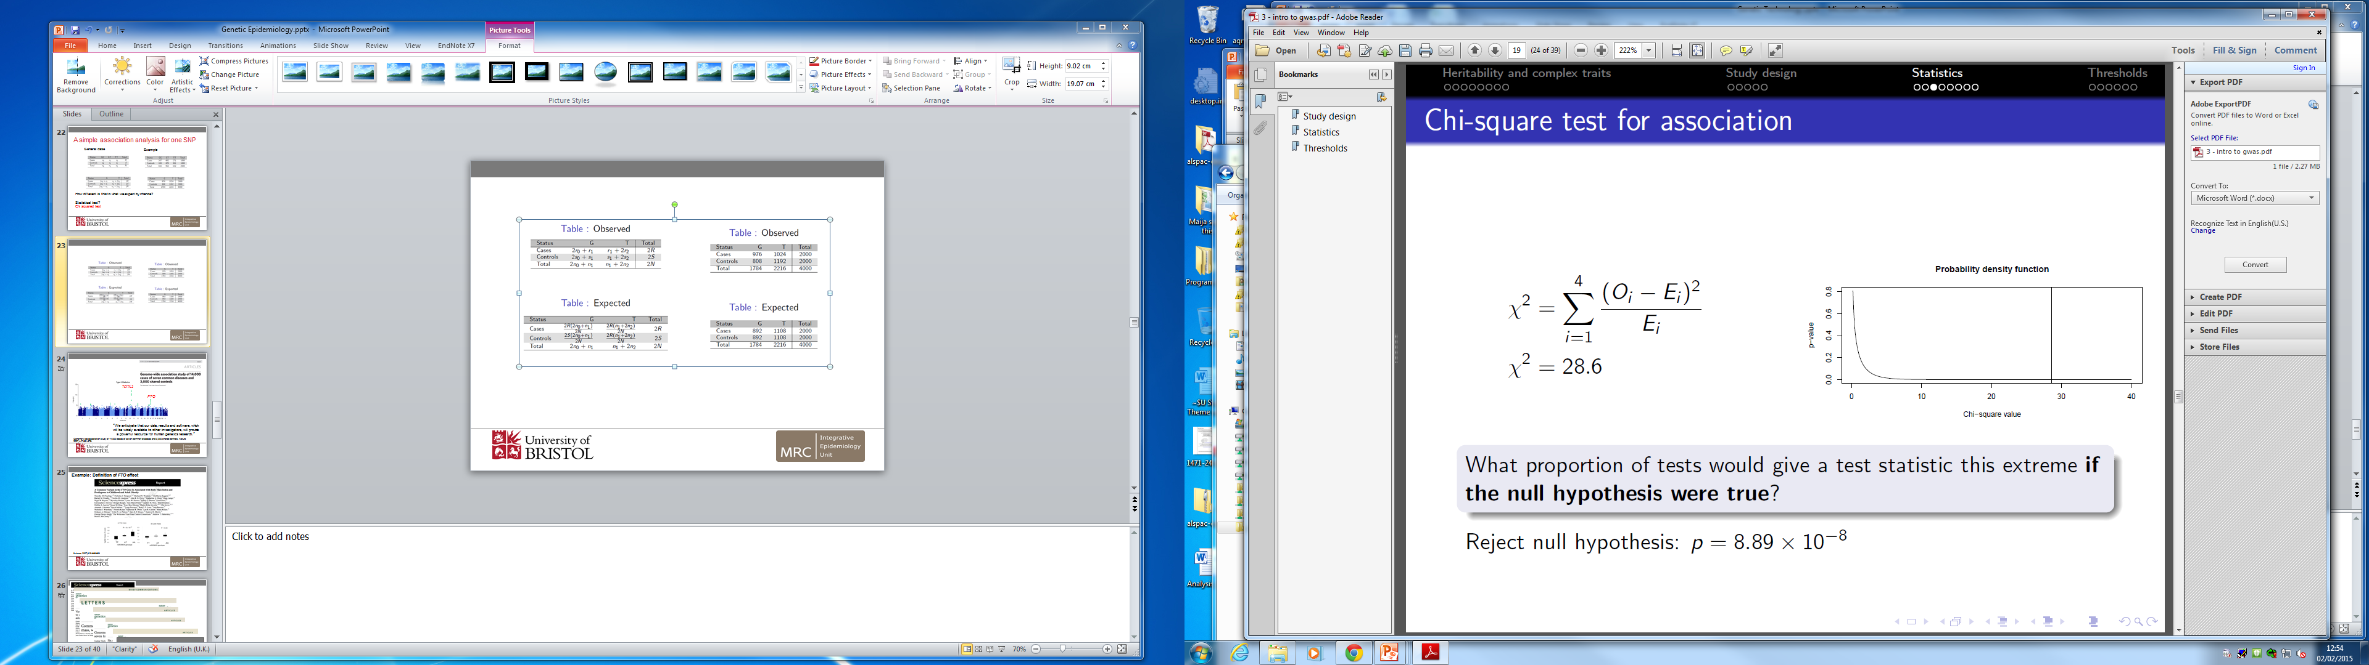

Slide 56
Odds ratio
What are the increase in odds of being a case for the G allele compared with T?
Odds ratio =
Odds of G in a case
Odds of T in a case
OR = 1; No association between genotype and disease
OR > 1; G allele increases risk of disease
OR < 1; T allele increases risk of disease
976/808 = 1.41
1024/1192

Slide 57
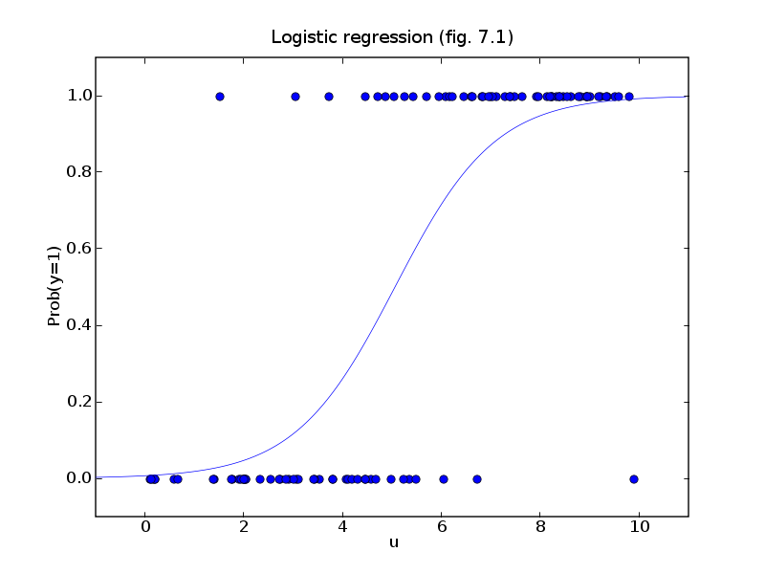
Logistic regression for complex models e.g. including covariates
Notes:
The disease phenotype is either 0 or 1
The independent variable is potentially continuous
It has an influence on the PROBABILITY of disease
The PROBABILITY of disease is estimated as a link function between the fitted values and the disease phenotype

Slide 58
Genetics of a disease phenotype
Notes:
With 200 causal loci we can have 401 different possible values
This creates a continuous genetic score, but for a disease trait we know it’s either 0 or 1.
The presumed underlying continuous scale is known as the liability.

Slide 59
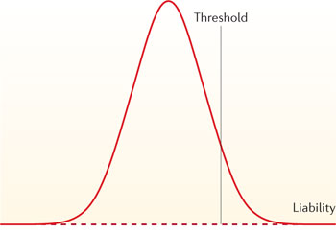
Liability threshold model
Unaffected individuals
Affected individuals
Adapted from van Dongen et al Nat Rev Gen 2012
Notes:
You need to have some minimum number of causal factors, and once you reach that number you develop the disease.

Slide 60
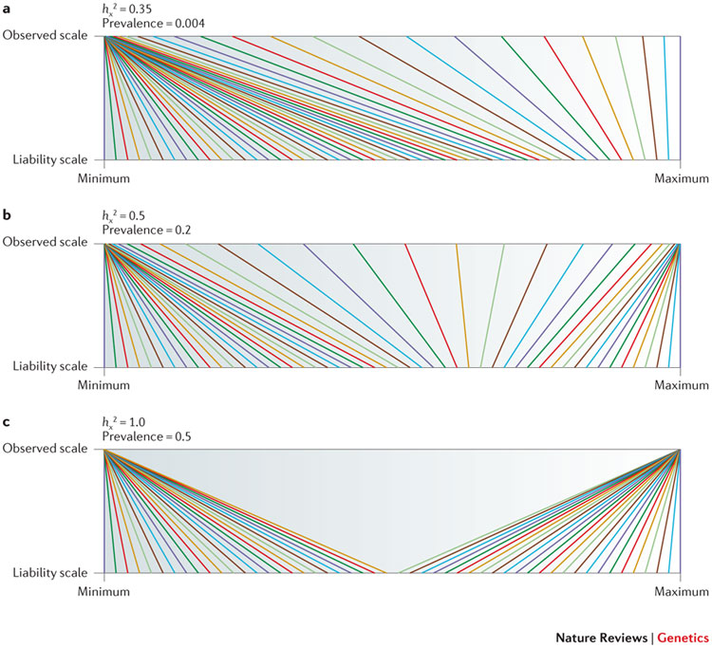
Notes:
Interpreting multifactorial influences on a disease outcome can be difficult
If you measure things on the liability scale it is equivalent to a quantitative trait
The addition of each new risk variant increases your genetic profile score additively, and independently
If you measure things on the observed scale (or the probability scale)
The addition of a new variant if you already have so many variants that you are going to get the disease anyway, has no effect
The influence is non linear and related to the heritability of the disease and the prevalence of the disease in the population.

